Slide 1
“Appearance and Character”

Slide 2
Character
Creative | not honest; disposed to lie
Selfish | having the quality or power of creating
Dishonest | feeling resentment against someone because of hat person's rivalry, success, or advantages
Patient | characterized by attacks, invasions
Aggressive | with fortitude and calm and without complaint, anger, or the like
Loyal | feeling or showing care and compassion
Caring | concerned primarily with one's own interests
Jealous | faithful to one's sovereign, government

Slide 3
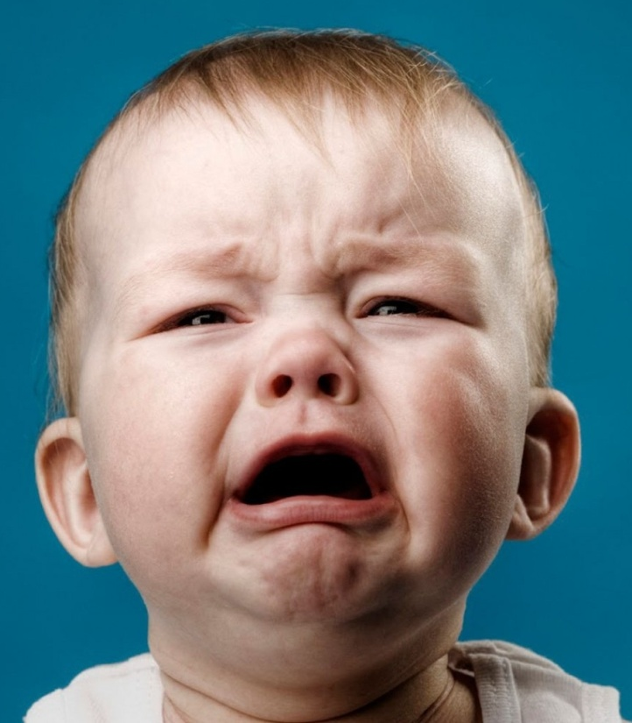
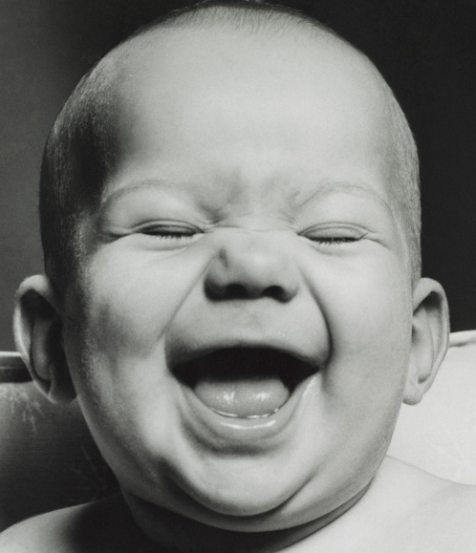
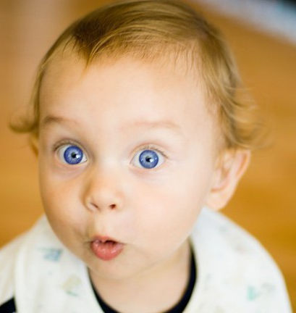
Bob
Peter
Nick

Slide 4
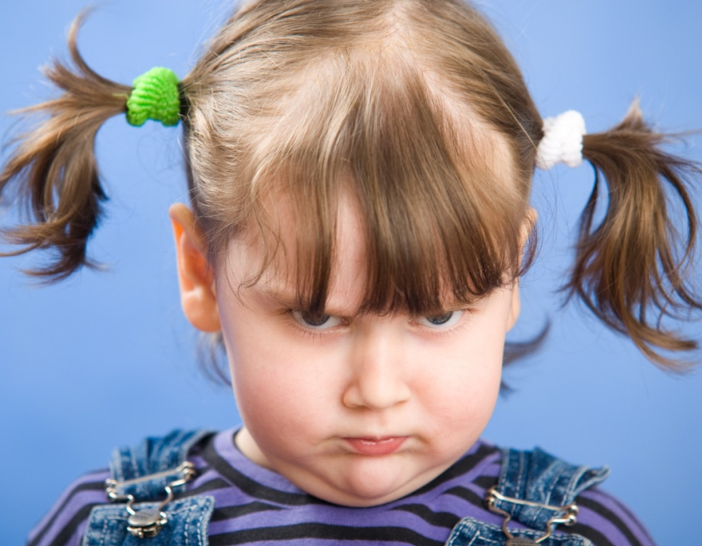
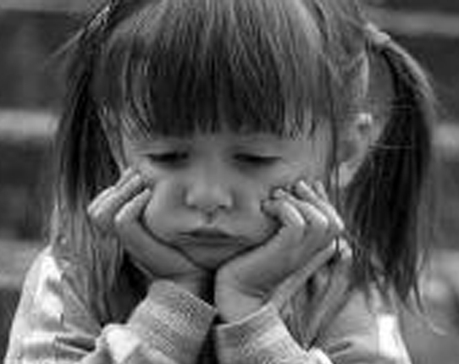

Kate
Bess
Helen

Slide 5
What’s the relationship between Kim and Julie?
Why is Kim angry?
What is the dialogue about?

